Slide 1
Running A Successful ZTNA Next L3E PoV
Mohanad Elamin
Solutions Specialist

Slide 2
BWAN PoV Timeline
1
2
3
4
5
PoV Agreement
Pre-Deployment
Deployment
PoV Results
PoV Conclusion
Customer
Establish Success Criteria
Coordinate overview meeting with necessary team
(ex. Network, Security, Applications)
Netskope
Discuss value proposition
Go over Non-Disclosure Agreement
Customer
Provide insights into the network topology.
Identify the application(s) to be tested and the application(s) owners.
Prepare and implement the deployment prerequisites.
Plan deployment resources.
Share shipping information in case if HW is required.
Netskope
Discuss Network Topology.
Go over deployment options and Best Practices.
Share deployment prerequisites and required software.
Ship the HW appliances if required.
Customer
Deploy the appliance
(physical or virtual)
Install and configure the BWAN appliance and related Network configuration.
Verify appropriate network traffic is routed correctly through the BWAN appliance..
Test applications and traffic flow.
Netskope
Assist in the deployment and configuration.
Ensure routing is done properly.
Customer
Enjoy full end-to-end connectivity and traffic optimization.
Netskope
Schedule review session.
Review Success Criteria and test results.
Customer
Identify next step.
Provide feedback on how well the Success Criteria was met or not.
Netskope
Discuss next steps.
Review pricing and quotes.
30 Days +

Slide 3

PoV Agreement
PoV Agreement
Pre-Deployment
Deployment
PoV Results
PoV Conclusion
Before you start
  Defined clear and measurable Success criteria in collaboration with customer - covering decision maker from Network, Security and Application Teams.
  Identify key decision makers and influencers (Business and Technical Champions).
Competitive considerations
  Identify the competition to plant traps.
Involve the BWAN specialist team.
Don’t confuse the customer with the terminology: ZTNA Next L3E = BWAN Client = SD-WAN Client = Borderless WAN client

Slide 4
Sample Use cases and Success Criteria
PoV Agreement
Pre-Deployment
Deployment
PoV Results
PoV Conclusion
UC 1: VoIP traffic steering via the Borderless SD-WAN Hub
    Expected results: VoIP Call should be successful over the ZTNA Next L3E tunnel.
UC 2: ZTNA Next + SWG
    Expected Results: User should be able to steer traffic to ZTNA Next L7, SWG and ZTNA Next L3E using single agent.
UC 3: Muti-tunnel traffic steering (Hubs deployed on two different DC sites)
    Expected Results: The client should be able to access resources on both Data Centers.
UC 4: Inbound access for remote troubleshooting (Server to client connectivity)
    Expected Results: User should be able to establish Server to client connectivity
UC 5: Client to Client communication
    Expected Results: User should be able establish connection between two clients running ZTNA Next L3E
UC 6: User Re-Authentication for application access through the BWAN Hub
    Expected Results: User should be able to enforce re-authentication after configurable period.
UC 7: Monitoring & Analytics
    Expected Results: Admin should be able to view telemetry from the client

Slide 5
Pre-Deployment
PoV Agreement
Pre-Deployment
Deployment
PoV Results
PoV Conclusion
Resources to review before customer discussion
  BWAN Documentation (Sign up required, customer domain need to be whitelisted. Request whitelisting on the #vt-borderlesswan-public slack channel)
  ZTNA Next L3E PoV Test Plan
  BWAN VT Page (Internal only)
  BWAN Showpad page (Internal only)
  BWAN Slack VT channel #vt-borderlesswan-public (Internal only)
  BWAN Slack Support channel #vt-borderlesswan-support (Internal only)

Slide 6
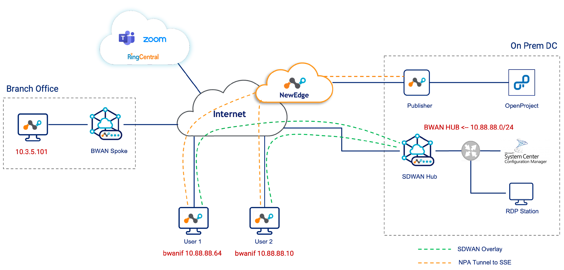
Network Topology Discussion
PoV Agreement
Pre-Deployment
Deployment
PoV Results
PoV Conclusion

Slide 7
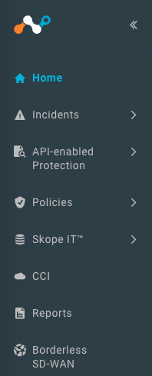
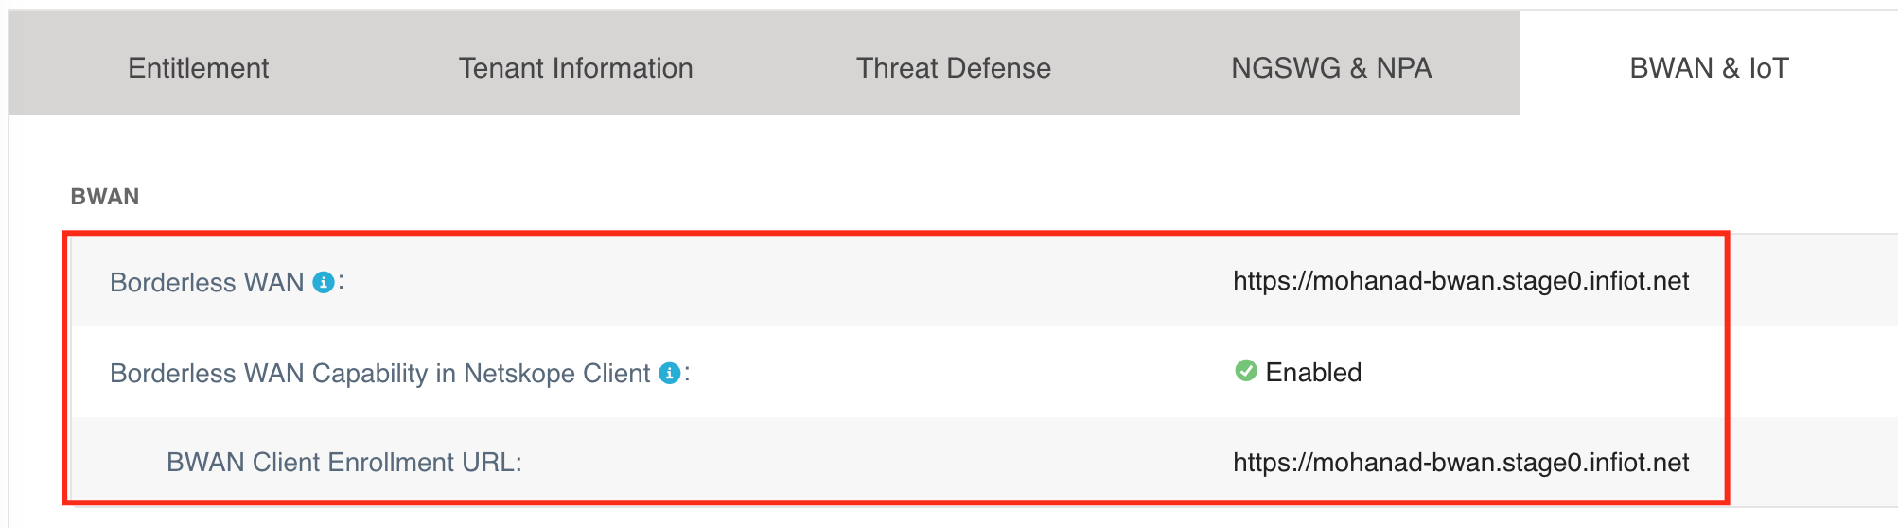
Prerequisites
PoV Agreement
Pre-Deployment
Deployment
PoV Results
PoV Conclusion
Request a BWAN Tenant by raising PSR to the BWAN team. (SSE tenant is also required even the PoV is for ZTNA Next L3E only).
Update URSA flags. (Requires Approval)
    Add the BWAN tenant URL to URSA Borderless WAN field. (BWAN & IoT tab)
    Borderless WAN Capability in Netskope Client URSA flag must be enabled. (BWAN & IoT tab)
    BWAN Tenant URL must be added to URSA BWAN Client Enrollment URL field. (BWAN & IoT tab)

Slide 8
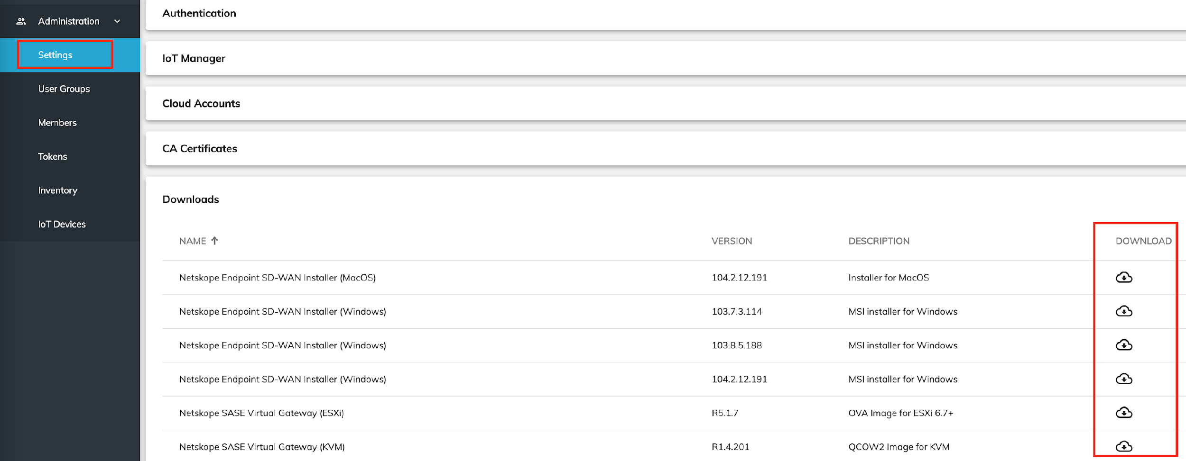
Prerequisites
PoV Agreement
Pre-Deployment
Deployment
PoV Results
PoV Conclusion
Share required software packages with the customer.
    Borderless SD-WAN gateway Virtual Machine Image.
    Borderless SD-WAN Client MSI.
    Software packages can be downloaded from Borderless SDWAN orchestrator UI under Administrations > Settings > Downloads

Slide 9
Prerequisites
PoV Agreement
Pre-Deployment
Deployment
PoV Results
PoV Conclusion
Port, Protocol and IP requirement for the gateway if it's deployed behind a firewall:
    Outbound
      Gateway to Orchestrator TLS1.2/443
      Gateways to link server UDP-8841
      Gateways to controller TCP-4500
      Gateway to gateway/hub UDP-4500 (can be custom configured)
      DNS UDP-53
      HTTPS access to <*.googleapis.com> and <gcr.io> for software packages download.
    Inbound
      UDP-443 (If behind a firewall - For ZTNA Next use case)
      UDP-4500 (If behind a firewall – Only needed if SD-WAN site to site Use cases is part of the PoV)
    If specific IP addresses are needed for the firewall rules, then the list can be found in this sheet.

Slide 10
Deployment steps
PoV Agreement
Pre-Deployment
Deployment
PoV Results
PoV Conclusion
Overall Deployment Workflow
Configure the Netskope SSE tenant.
Configure the Borderless SD-WAN Orchestrator tenant.
Deploy the SASE Gateway Hub.
Configure the routing required on the Gateway Hub.
Create the Borderless SD-WAN Client policy.
Create the Borderless SD-WAN Client template.
Deploy Endpoint SD-WAN as an add-on to the Netskope Client.
End-to-End config guide: https://netskope.document360.io/docs/endpoint-sd-wan-windows-and-mac

Slide 11







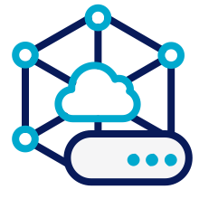


Use cases - UC 1: VoIP traffic steering
PoV Agreement
Pre-Deployment
Deployment
PoV Results
PoV Conclusion
SASE Orchestrator
SASE
Controller
NewEdge
Data Center 1
User 1
bwanif 10.88.88.77
BWAN HUB <-- 10.88.88.0/24
Internet
SDWAN Hub 1
VoIP Server
Policy
User 2
User 1 can connect to VoIP Server
VoIP Server can connect to User 2
bwanif 10.88.88.64
Management Plane Connection
SDWAN Overlay
Tunnel to SSE
SIP/VoIP/UC protocols (RTP, SIP, Stun, etc.)

Slide 12










Use cases - UC 2: ZTNA Next + SWG
PoV Agreement
Pre-Deployment
Deployment
PoV Results
PoV Conclusion
Web
User 1 can access to Private App via Publisher
User 1 can access to SaaS and Web Applications via the SWG
SaaS
Data Center 1
SASE Orchestrator
SASE
Controller
NewEdge
Policy
Publisher
Private Applications
Internet
User 1
BWAN HUB <-- 10.88.88.0/24
bwanif 10.88.88.77
RDP Station
SDWAN Hub 1
Management Plane Connection
Policy
SDWAN Overlay
Tunnel to SSE
Client to Server Connection
Admin can RDP to User 1
Server to client Connection

Slide 13
Use cases - UC 3: Muti-tunnel traffic steering
PoV Agreement
Pre-Deployment
Deployment
PoV Results
PoV Conclusion
Data Center 1
SASE Orchestrator
SASE
Controller
BWAN HUB <-- 10.88.88.0/24
NewEdge
RDP Station
SDWAN Hub 1
Internet
Data Center 2
User 1
BWAN HUB <-- 10.88.88.0/24
bwanif 10.88.88.77
SDWAN Hub 2
Applications
Management Plane Connection
SDWAN Overlay
Tunnel to SSE

Slide 14
Use cases - UC 4: Server to client connectivity
PoV Agreement
Pre-Deployment
Deployment
PoV Results
PoV Conclusion
Data Center 1
SASE Orchestrator
SASE
Controller
BWAN HUB <-- 10.88.88.0/24
NewEdge
RDP Station
SDWAN Hub 1
Internet
Data Center 2
User 1
BWAN HUB <-- 10.88.88.0/24
bwanif 10.88.88.77
SDWAN Hub 2
Applications
Management Plane Connection
SDWAN Overlay
Tunnel to SSE
RDP connection, Server to client

Slide 15
Use cases - UC 5: Client to Client communication
PoV Agreement
Pre-Deployment
Deployment
PoV Results
PoV Conclusion
SASE Orchestrator
SASE
Controller
NewEdge
Data Center 1
User 1
bwanif 10.88.88.77
BWAN HUB <-- 10.88.88.0/24
Internet
SDWAN Hub 1
Applications
Policy
User 2
User Group 1 can connect to each other
bwanif 10.88.88.64
Management Plane Connection
SDWAN Overlay
Tunnel to SSE
RDP connection, Client 1 to Client 2

Slide 16
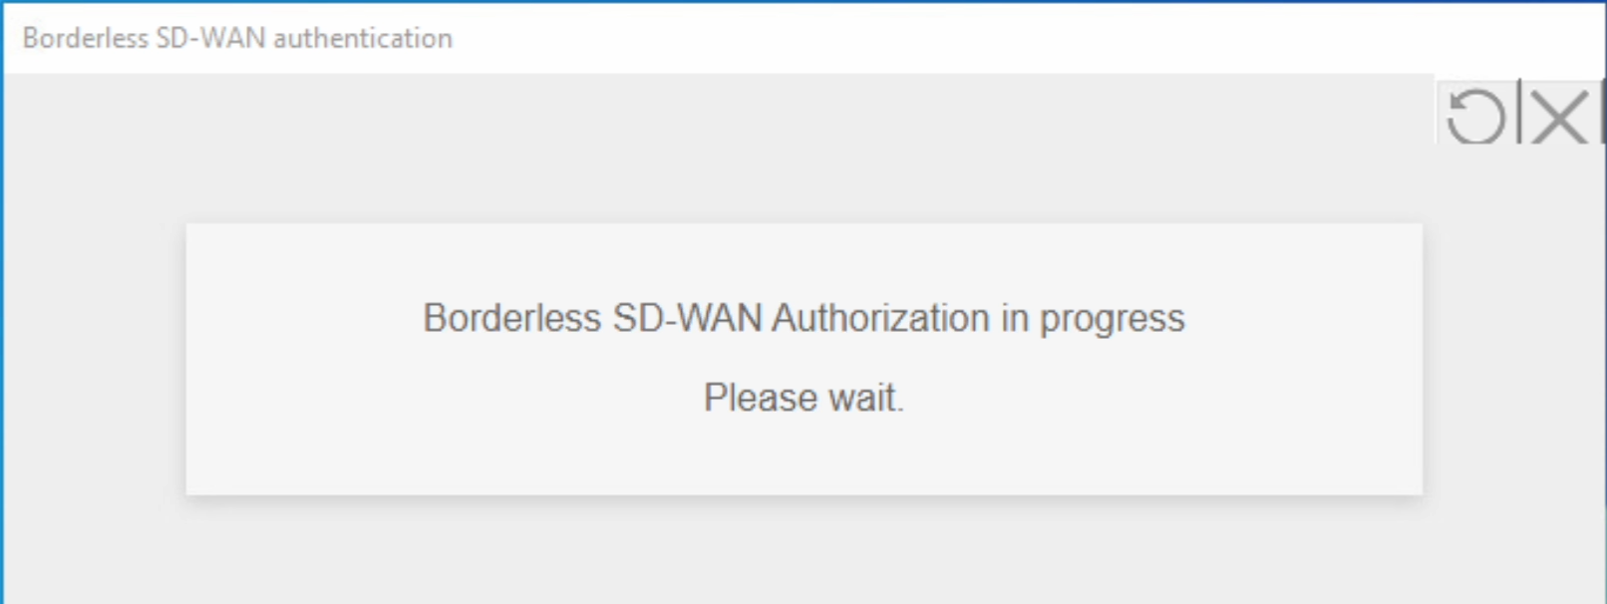
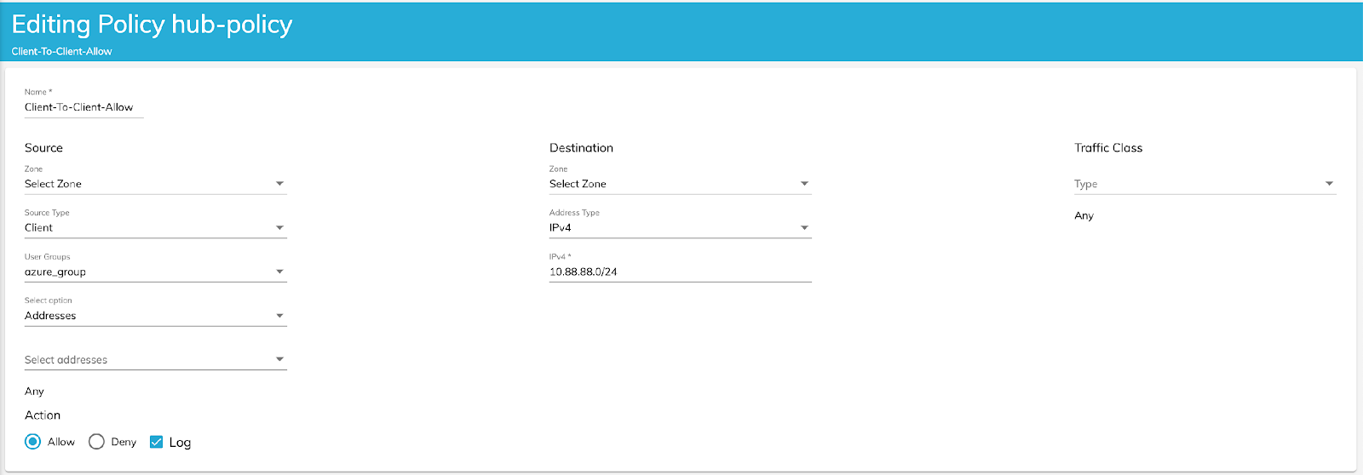
Use cases - UC 6: User Re-Authentication for application access
PoV Agreement
Pre-Deployment
Deployment
PoV Results
PoV Conclusion

Slide 17
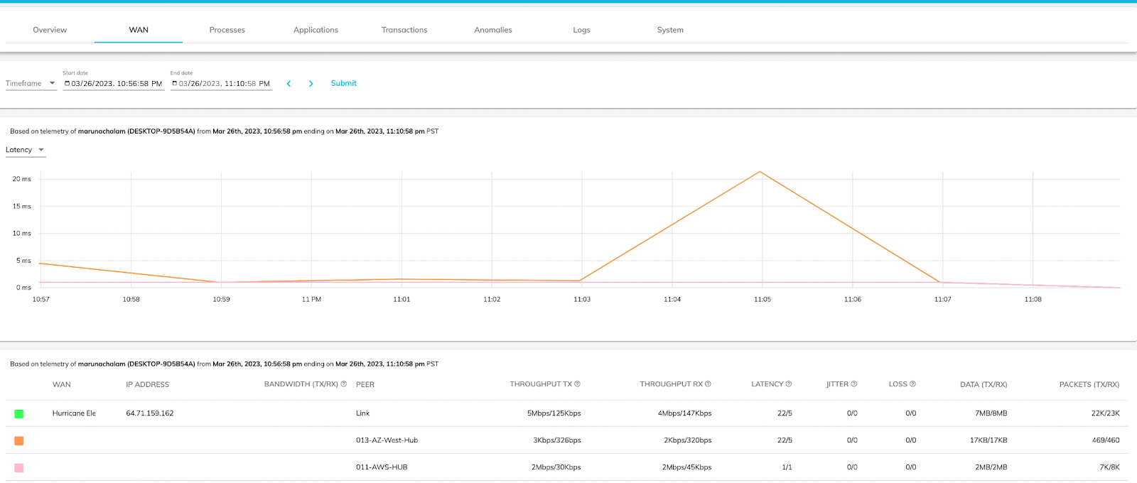
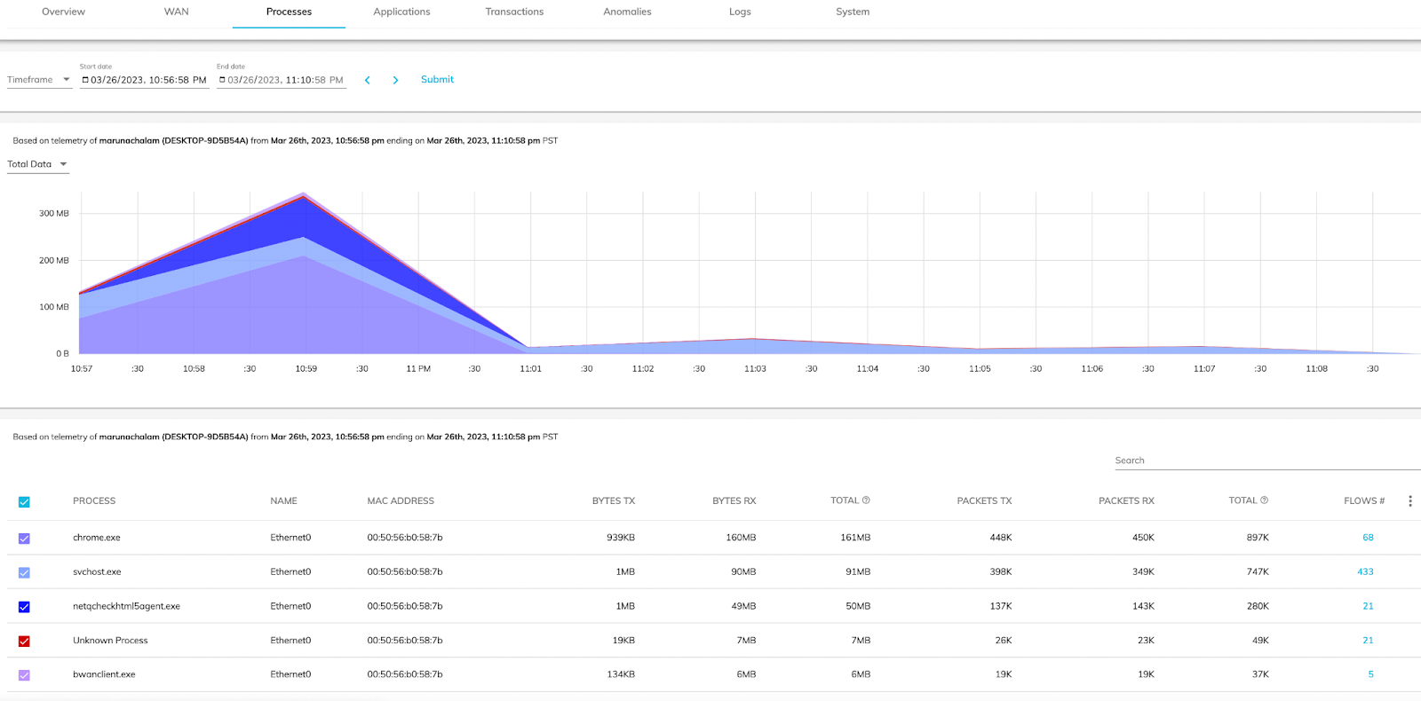
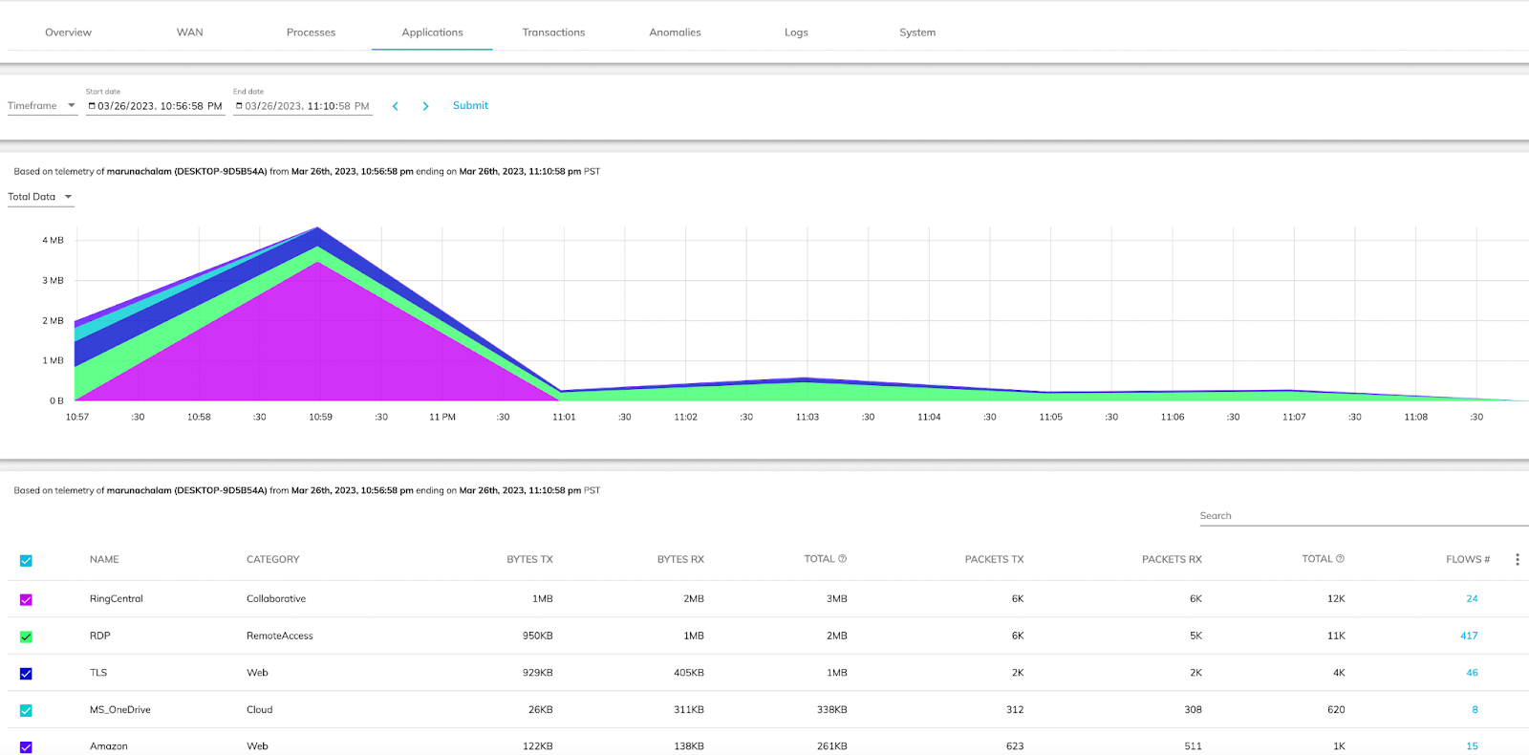
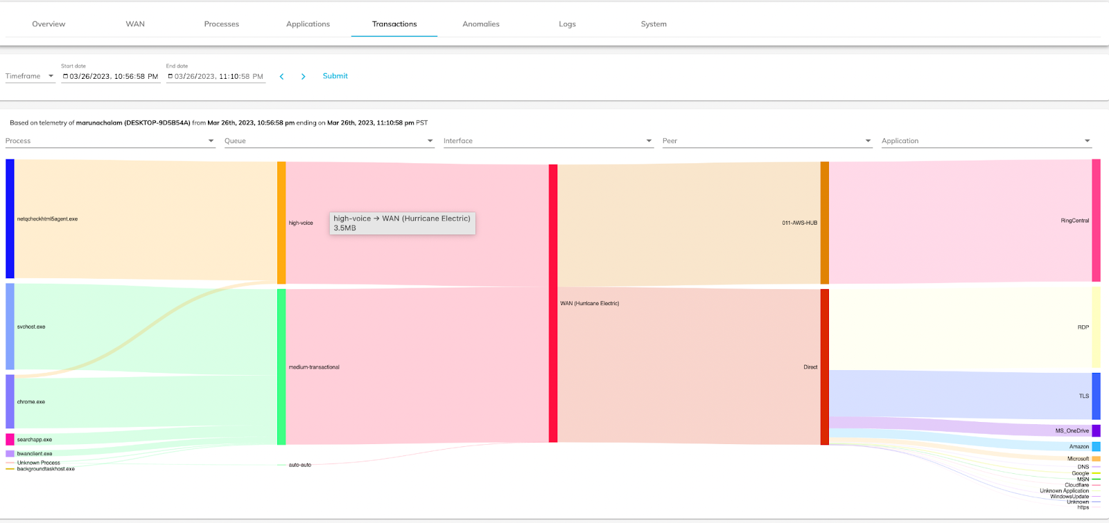
Use cases - UC 7: Monitoring & Analytics
PoV Agreement
Pre-Deployment
Deployment
PoV Results
PoV Conclusion
Processes and flow details
WAN monitoring
Applications and Flow details
Transactions View

Slide 18
PoV results
PoV Agreement
Pre-Deployment
Deployment
PoV Results
PoV Conclusion
Go through the success criteria and results
  Articulate the story and vision. (NetskopeOne, Single Agent, Full SASE, AppX and optimization.)
  Show the overall value of the solution.
  Deliver a presentation with use cases and success criteria as a final report.
  Discuss what is working and what is not.
Ask for feedback and enhancement requests.

Slide 19

Conclusion
PoV Agreement
Pre-Deployment
Deployment
PoV Results
PoV Conclusion
Collect feedback about the PoV and test result.
If it is a technical win then discuss next step, pricing, quote, etc.
If it is not a technical win, then share feedback and reasons with BWAN team.

Slide 20
References
  BWAN Documentation (Sign up required, customer domain need to be whitelisted)
  ZTNA Next L3E PoV Test Plan
  BWAN VT Page (Internal only)
  BWAN Showpad page (Internal only)
  BWAN Slack VT channel #vt-borderlesswan-public (Internal only)
  BWAN Slack Support channel #vt-borderlesswan-support (Internal only)

